Slide 1
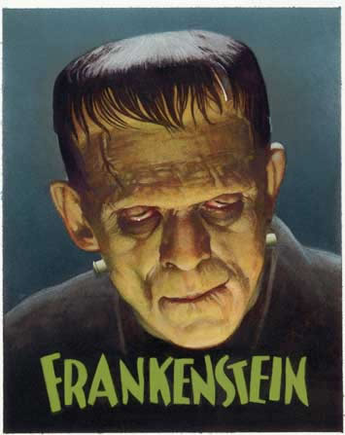
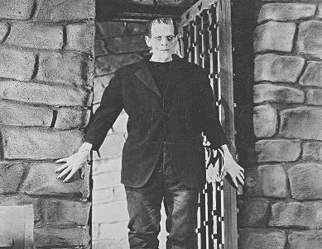
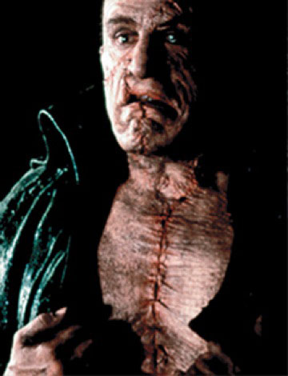
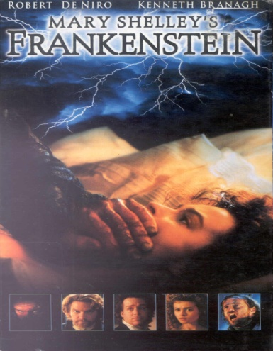
Frankenstein by Mary (Wollestonecraft-Godwin)Shelley

Slide 2
Mary Shelley Biography
Mary Shelley (1797-1851) was born in England.
Her father, William Godwin, was a philosopher & writer.
Her mother, Mary Wollenstonecraft, was a feminist & writer.
Mary’s mother died 11 days after giving birth to her.
Mary was a voracious reader who was influenced by the writers who were friends of her father.
Mary Shelley faced tragedy and adversity, growing up without her mother and later experiencing the death of her own children.
In 1814, Mary met her future husband, Percy Shelley.
She got the idea to write Frankenstein when British poet Lord Byron suggested a group of his guests, including Shelley, write ghost stories to pass time.

Slide 3
Mary Shelley The Age of Romanticism & Gothic Literature
Mary Shelley grew up and wrote during the Age of Romanticism (1798-1832), when the importance of intellectual thinking was replaced by the importance of feelings.
The period of Romanticism focused on nature and the common people. It also allowed people to become interested in the mysterious and the supernatural.
Romantics believed that natural human goodness was held back by civilization.
The emphasis of the period was on the darker aspects of human nature.
This new thinking led the way for writers, such as Mary Shelley, and the genre of Gothic literature, where elements of horror and romance are mixed together in stories.

Slide 4
Mary Shelley The Age of Romanticism & Gothic Literature
In Gothic writing, the individual takes center stage, along with human emotion, intuition, and an awe of nature.
There was a progression of thought that exposed humans as vicious and perverse.
Additionally, writers thought that perhaps the light of civilization might not always triumph over darkness.
An important element of the whole romantic movement was an emphasis on the natural – the darker aspects of existence.
Eighteenth century thinking, which had viewed life by the bright light of reason, made a transition to the nineteenth century thinking which dared to acknowledge that humans could be dark and evil.

Slide 5
Mary Shelley The Age of Romanticism & Gothic Literature
The Darkness of the Human Soul:
In every human, there is a hard core darkness and violence.
Because this darkness is a universal condition of human nature, it can never be truly overcome, only limited or restrained.
The darkness of human nature is related to emotion and stands in contrast to the light of reason.
The darkness of the human soul may turn outward, causing pain and sorrow to others. At the same time, it causes as much or more suffering from within.

Slide 6
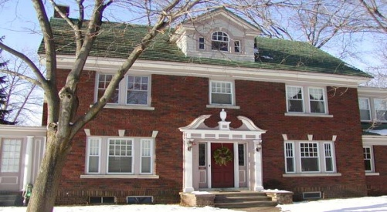
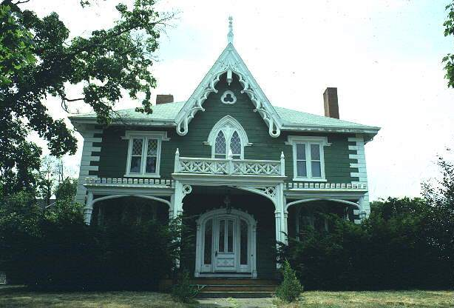
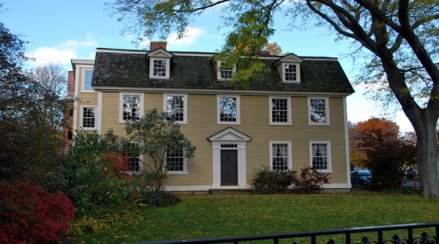
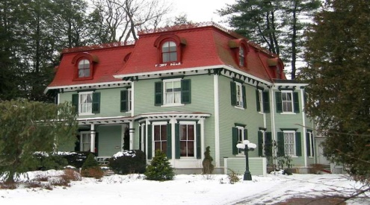
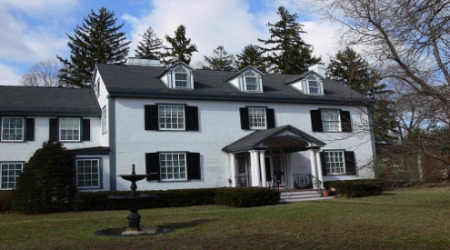
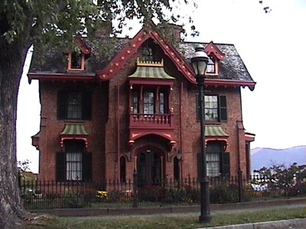
Mary Shelley Gothic Style - Architecture
Elements of the Gothic genre reached beyond literature. In architecture, the classic and symmetrical style of buildings gave way to the rigid Gothic style.

Slide 7
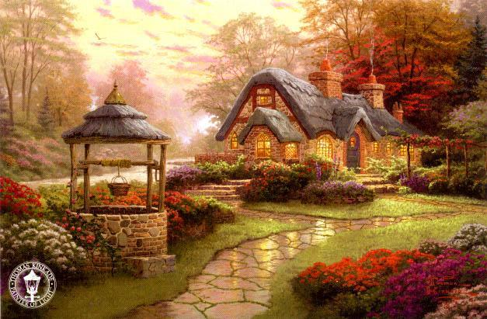
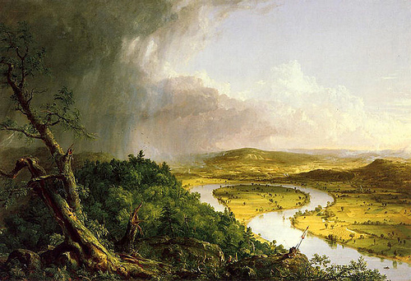
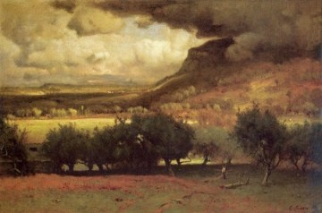
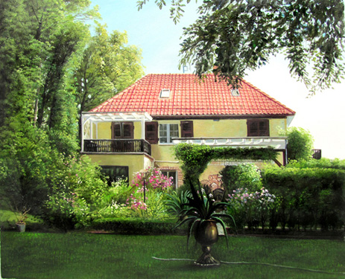
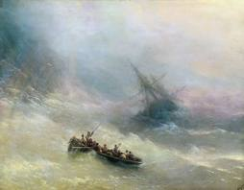
Mary Shelley Gothic Style - Paintings
In paintings, the decorative landscapes were replaced by the impressions of naturalistic impressions of swirling waters and stormy skies.

Slide 8
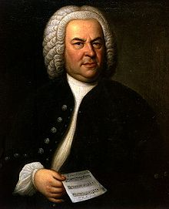
Mary Shelley Gothic Style - Music
In music, the orderly progressions of Bach gave way to the tempest of Beethoven.
Johann Sebastian Bach

Slide 9
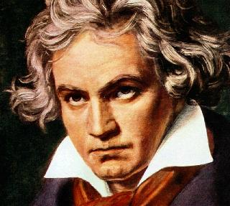
Mary Shelley Gothic Style - Music
In music, the orderly progressions of Bach gave way to the tempest of Beethoven.
Ludwig Van Beethoven

Slide 10
Mary Shelley Gothic Style - Poetry
In Gothic poetry, the dry, orderly stanzas were replaced by lyrical and passionate cries.
The dry, pedantic stanzas of Samuel Johnson and Alexander Pope fell out of fashion, and the lyrical and passionate cries of Byron and Shelley were greatly appreciated.

Slide 11
Mary Shelley Gothic Style - Poetry
Celia
By Alexander Pope
Celia, we know, is sixty-five, Yet Celia's face is seventeen; Thus winter in her breast must live, While summer in her face is seen. How cruel Celia's fate, who hence Our heart's devotion cannot try; Too pretty for our reverence, Too ancient for our gallantry!

Slide 12
Mary Shelley Gothic Style - Poetry
Bereavement
By Percy B. Shelley
How stern are the woes of the desolate mourner
As he bends in still grief o'er the hallowed bier,
As enanguished he turns from the laugh of the scorner,
And drops to perfection's remembrance a tear;
When floods of despair down his pale cheeks are streaming,
When no blissful hope on his bosom is beaming,
Or, if lulled for a while, soon he starts from his dreaming,
And finds torn the soft ties to affection so dear.
Ah, when shall day dawn on the night of the grave,
Or summer succeed to the winter of death?
Rest awhle, hapless victim! and Heaven will save
The spirit that hath faded away with the breath.
Eternity points, in its amaranth bower
Where no clouds of fate o'er the sweet prospect lour,
Unspeakable pleasure, of goodness the dower,
When woe fades away like the mist of the heath.

Slide 13
Mary Shelley Her novel - Frankenstein
In the novel, Frankenstein, the brutal aspects of human beings are explored through the development of characters.
A major theme in the novel Frankenstein is the treatment of the poor and uneducated people in society.
Frankenstein was first published under the name “anonymous.”
Originally, 2 publishers rejected the novel, but today more than 40 movie versions have been released and millions of copies published.
One third of the novel is written from the point of view of the creature. The one violent act of nature that repeats throughout the novel is lightning.

Slide 14
Court Case 2008-2009

Slide 15
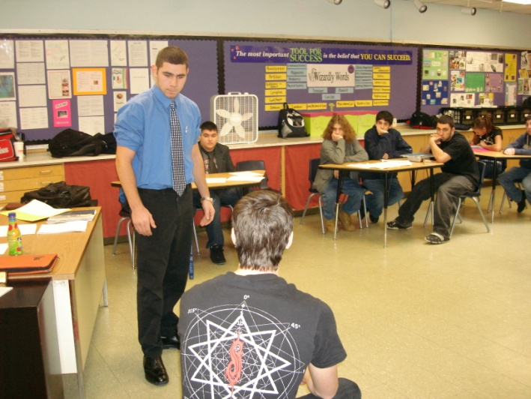
Court Case 2009-2010

Slide 16
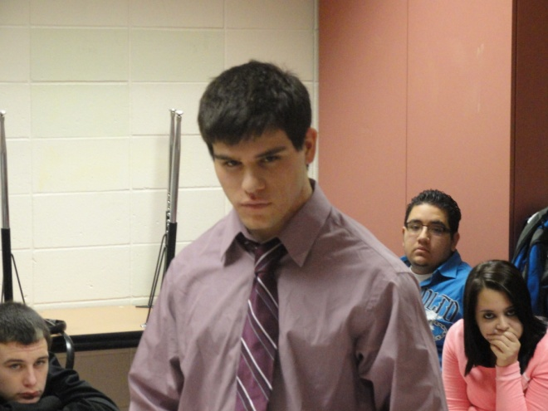
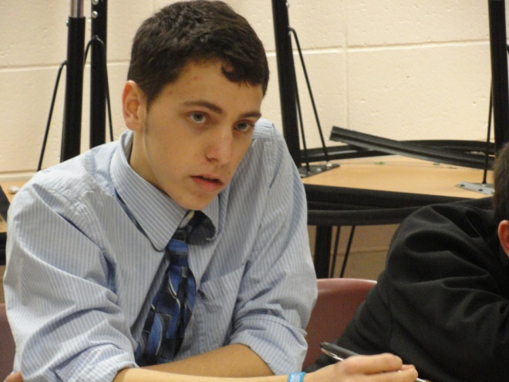
Court Case 2010-2011

Slide 17
Themes & Court Case Terms

